Slide 1
Network-on-FPGA
Aleksander Ślusarczyk

Slide 2
Network-on-FPGA
Network
  topologies
  routing
Data processor
  mMIPS
  network interface
uP
uP
NI
Mem
IF

Slide 3
Network
Easy to implement
Easy to use
  No software assistance required
  Reliable
  No scheduling/routing

Slide 4
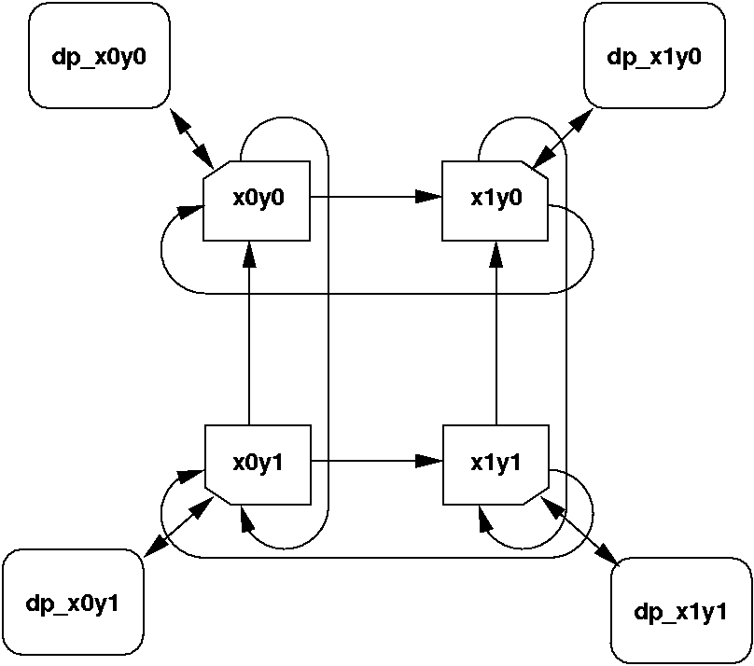
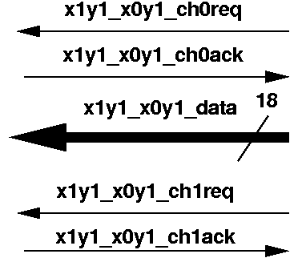
Dally’s network
Torus topology
E-cube routing
Unidirectional links
  deadlock-free (2 virtual channels per link)

Slide 5
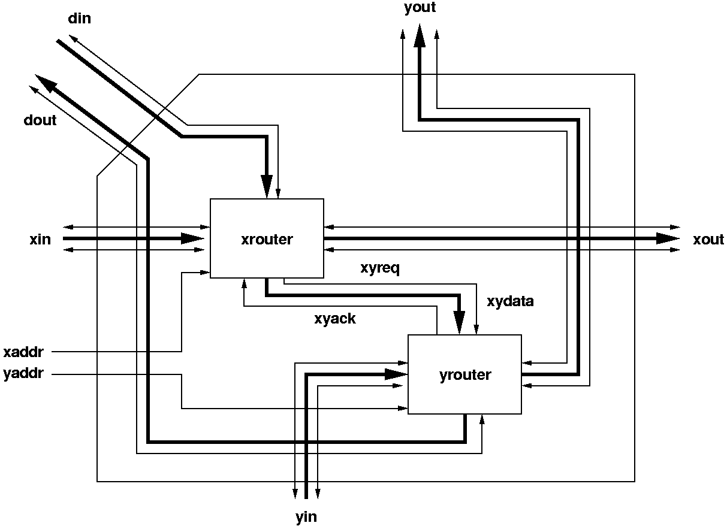
Router

Slide 6
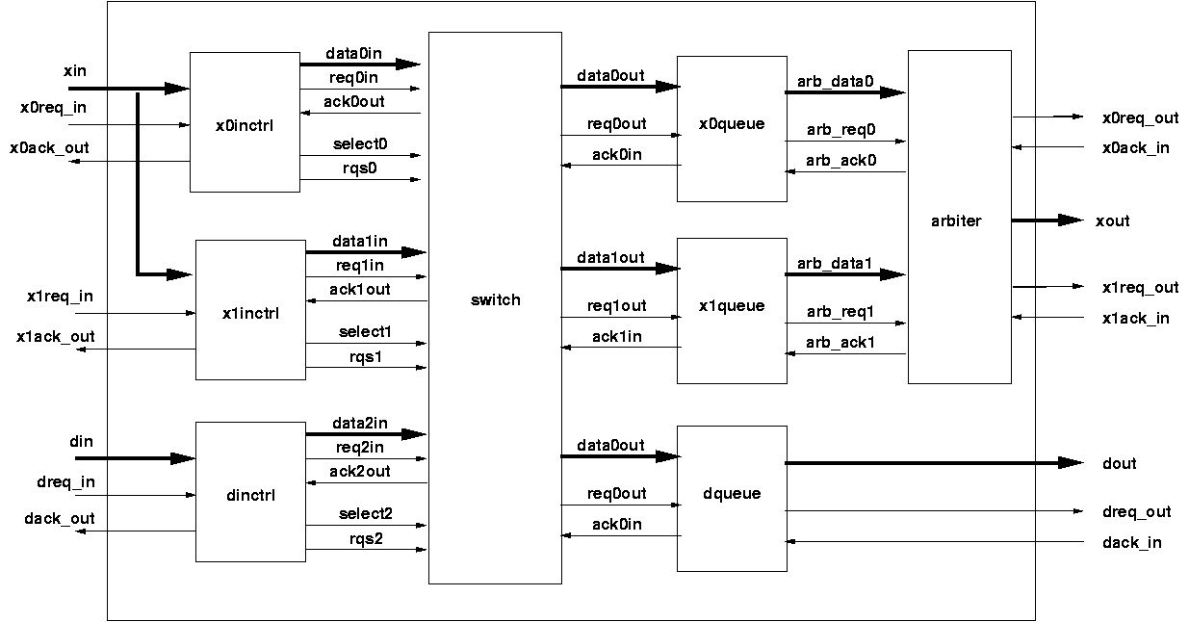
Sub-router
H
16b
D
16b
T
16b

Slide 7
Dally’s network
Guaranteed delivery, deadlock-free
  no software required, reliable out-of-the-box
Fixed route
  impossible congestion avoidance, load balancing
  no timing guarantees

Slide 8
Topologies - Mesh
Bidir links (double the connections)
Asymetric at edges

Slide 9
Topologies - Tree
One route
Bidir links
Top-level nodes overloaded

Slide 10
Routing
E-cube
Interval
  Range of addresses assigned to output port
  Deadlock-free labellings for many topologies
1
[2,5]
[1,1]
[1,2]
[3,5]
3
2
[4,5]
4
5
[1,2]
[3,5]
[1,4]

Slide 11
Route tables
Time slots
In a time slot one connection active
t \ o O1 O2 O3
t1 I1
t2 I2
t3 I1
Compile-time fixed
Scheduling required
Contention-free
Guaranteed timing
O2
I1
O1
I3
O3
I2

Slide 12
Routing - Dynamic
Header contains routing information
  E.g. streetsign: “goto x, turn left, goto y, turn right, … ”
  Determined by user application or Network Interface (e.g. routing table)
Intermediate router determines best route

Slide 13
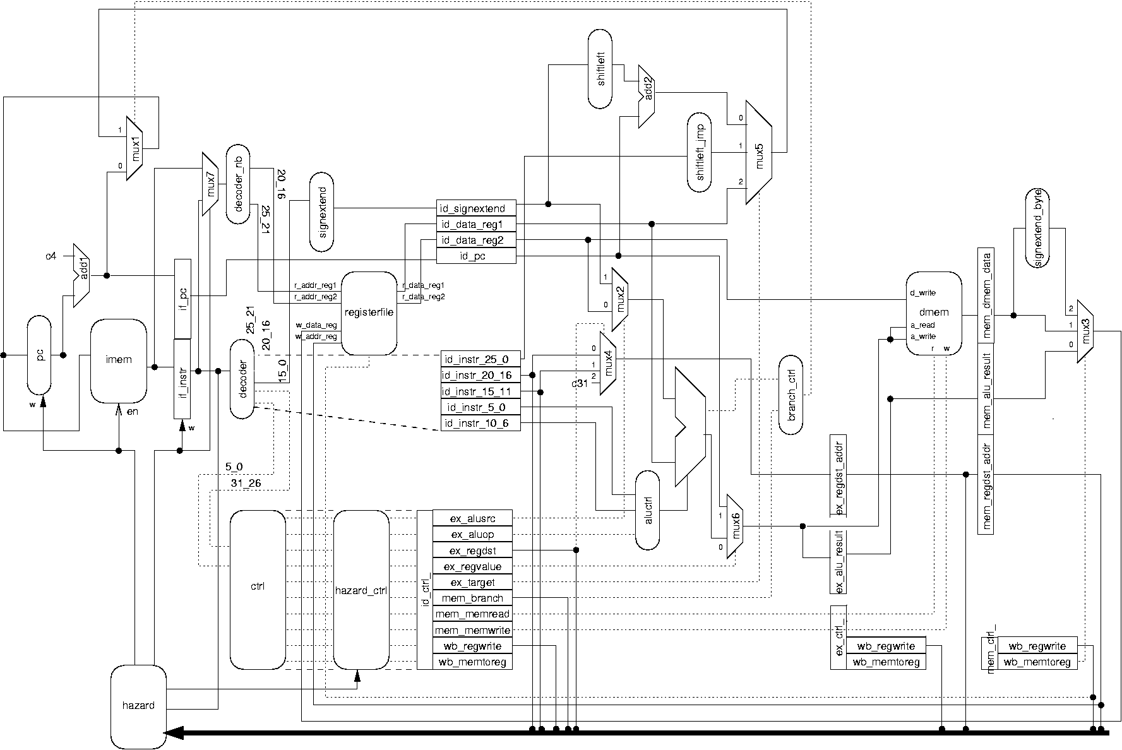
Data processor
Starting point – mMIPS developed for OGO
  pipelined
  28 instructions
  separate D/I memory
  synthesizable SystemC

Slide 14
Network interfacing
Memory mapped network device
IM
DM
NI
mMIPS
Data: 0x8000000
Ctl: 0x8000004
address
send
data_rdy
send_rdy

Slide 15
Memory
Data and instruction cache
  Currently : local main memory
  Plan : network access to memory
RAM
MEMIF
NI+
I$
D$
NI
IM
DM
mMIPS

Slide 16
Implementation
mMIPS : 600 slices
Cache : 2 x 300 slices
Router : 500 slices
N.I. : 100 slices
+ : 1800
Virtex2 3000 : 15,000 slices + 200 KB RAM
@ 30-50 MHz

Slide 17
Software
LCC compiler for mMIPS (Sander Stuijk)
Communication library (Mathijs Visser)
  C send/receive primitives (blocking/non-blocking)
  networked JPEG

Slide 18
Software for the Network-on-FPGA
Mathijs Visser
(student E)
January 2004 , version 1.0
Notes:
Introduce yourself: student E
Invited to help on the software side of the mMips NoC: as part of practical training @ ICS
Questions? Just ask.

Slide 19
Introduction
Goals:
Create a communications library for C.
Improve the programmability of the mMips network
Create and test a multi processor application
Verify HW and SW correctness
Context:
Courses for twaio’s
Network-on-Chip flagship
Notes:
My role in the project/context and also the goal of my practical training is:
Improve the programmability of the FPGA by creating a C library that encapsulates the internals of communication, uses a standard (ptheads, message passing, mpi, etc.) → for the user (C programmer)
Create a realistic multi processor application that runs on the FPGA using that library. Fairly complex. The design process should reveal HW/SW problems & shortcomings in software tools.
Context: purpose of my work / necessity:
NoC=assignment @ courses, but c programmers & essential that most important bug out of HW and SW
NoF plays a role in the predictable design program, since it can consist of predictable components (e.a. no cache…)

Slide 20
Overview
Current software tools
  The C compiler (lcc)
  C communications library
  The simulator (SystemC)
  Simple C debugging library
Multi processor applications
  Two examples
  Design process & FPGA demonstration
Summary
Notes:
In this presentation:
software tools: existing & created by me for the C programmer
Discuss two multi processor programs developed for the miniMips network. Of one of them:
the design process will be discussed
And will be demonstrated using the actual FPGA
After / during the demo more on:
- the current status &
- plans to tackle current problems
A summary concludes the presentation

Slide 21
C compiler (LCC)
Advantages
  Designed for retargetability
  Ported by Sander Stuijk for mMips
  Different memory layouts supported without recompilation
Disadvantages
  ANSI/POSIX libraries not implemented
  No debugging information
  Ongoing test process
Notes:
Lcc is chosen compiler for the miniMips
Sander Stuijk ported lcc, to the miniMips: compiles C code to machine code for the miniMips.
No debug: cannot associate instruction with a line in source code, cannot watch on variables.
These shortcomings are compensated somewhat by the hardware simulator and a custom debug library
Potential problems with the bitwise shift functions → many of them will be discovered during app development

Slide 22
mMips communication revisited
Memory mapped communication
Request transmission of Data_word
Check whether Data_word valid?
Set destination node address
Status_word
Data_word
Contains received data,
Location to write outgoing data to
Max. physical address
0x0000
32 bits
Notes:
Before Communications api: repeat internals of mMips communication, but now from the software viewpoint.
int sc_send(const int address, const void *data, const int size_in_bytes)
int sc_receive(void *data, const int size_in_bytes)
-
The router allows no interruptions when sending a packet. When a packet is being sent over the network, the network operations of other nodes stall until this packet has been sent.

Slide 23
C communications library
Goal
Simplify inter-processor communications for the C programmer (= user).
Constraints
Time: Design and test in around 40 hours
Interface: Easy to use, encapsulate HW details
ROM memory: Should require less than 1kbyte
Adhere to a well know standard.
Notes:
C programmer should not be bothered with e.g.
Order in which to write to or read from data_word and control_word
Bit ranges of status bits and node addresses
Time: I should be able to complete it along with other work within the time available within my practical training
Interface: Useful when the mMips is used in courses. Hiding HW details saves time when designing multi processor applications. User should see only a few well defined C functions. If e.g. message passing: then behave as expected from textbook, even if extra software steps are required

Slide 24
C communications library
Possible communication scheme:
Message passing
Blocking send and receive
Non-blocking send (= try) and receive (= peek)
Possible implementation:
C Function | Description
sc_send_word() and sc_receive_word() | Send or receive exactly 4 bytes
sc_send() and sc_receive() | Send / receive any number of bytes.
¥
¥ Retry count as optional parameter
Notes:
Time: I should be able to complete it along with other work within the time available within my practical training
Interface: Useful when the mMips is used in courses. Hiding HW details saves time when designing multi processor applications. User should see only a few well defined C functions.

Slide 25
C communications library
Advantages of Message Passing
Directly supported by hardware
  Small code base (meets memory constraints)
  Easy to implement (meets time constraints)
Forms basis for more complex protocols
  Only two operations (meets constraints for simplicity)
  Uses message passing (= a standard, as required)
Notes:
int sc_send(const int address, const void *data, const int size_in_bytes)
int sc_receive(void *data, const int size_in_bytes)
-
The router allows no interruptions when sending a packet. When a packet is being sent over the network, the network operations of other nodes stall until this packet has been sent.

Slide 26
Send and receive primitives
int sc_send(const int address,
const void *data, const int size_in_bytes)
int sc_receive(
void *data, const int size_in_bytes)
address Relative address of destination node
data Pointer to source/destination data
Return value Number of bytes actually sent or
received.

Slide 27

Simulator (SystemC)
System level design tool
  C++ Class Libraries for
  hardware constructs, such as adders
  SystemC model of the mMips network (Alex)
  Standalone executable can be generated
Notes:
Another tool to lighten the burden of the sofware programmer.

Slide 28
Simulator (SystemC)
Important debugging tool
  VCD tracings
  Memory dumps (ROM & RAM)
  Spy module:
    Spy on instruction pointer (IP) & communication
    Watch read/writes on specific addresses
    Stop simulation when IP at specific address
    Additional options…
Notes:
VCD: too detailed
Dumps: useful for simple C debug library, discussed next
The standalone executable is an essential debugging tool
Ad “Additional options…” :
Implement magic address. Writing to that address results in outputting to the stdout of the simulator
Mapping between instruction pointer and source code

Slide 29

C library for debugging
Desirable because:
LCC cannot generate debugging info
No CRT/console, so no printf()
Notes:
Why useful for both simulator and FPGA? (memory dump at end of simulation and SystemC).

Slide 30
C library for debugging
Solution to debugging problem?
Implements a printf()-variant
Writes output to memory
  Useful for both Simulator
  and FPGA implementation.
FPGA memory
0x8000
Program data and Stack
- Reserved -
Output of printf() is stored here
0x4000
Instructions
0x0000
Notes:
Why useful for both simulator and FPGA? (memory dump at end of simulation and SystemC).
Requires no hardware modifications, only a small change in the memory layout file of the lcc compiler (minimips.link).

Slide 31
Multi processor applications
(for the mMips network)
  Two examples
  Design process & FPGA demonstration
Notes:
Practical part of my presentation.

Slide 32
Multi processor applications
Two applications were developed
  Multi processor JPEG decoder
  “Gossip”: a small message circulates the network
Both resulted in improvements of both compiler
and mMips
“Gossip” application & design process will be demonstrated
Next slide: some words on the JPEG decoder
Notes:
Improvements:
Compiler:
global variables: gp register was left uninitialized)
Improvements of the C shift library
Hardware: problem with jump-delay-slot (“Your minimips.md files instruct the compiler to not reorder the instructions. As a result, it will not place a nop after a function call return. Therefore your functions may (will in general) overlap when they are executed because the first instruction of the next function is placed in the call delay slot. – Sander Stuijk”
But first: some words on the JPEG decoder

Slide 33

JPEG decoder
Input:
JPEG image
2x2 mMips
Network
Output:
BITMAP image
Notes:
Initial test application and demo, but: not finished yet…

Slide 34
JPEG decoder
Not finished yet…
Large: ± 500 lines of code
Limited debugging facilities
Long simulation times:
2 hours for 16x16 image
Discovery of compiler or hardware issues
Input:
JPEG image
2x2 mMips
Network
Output:
BITMAP image
Notes:
Initial test application and demo, but: not finished yet…

Slide 35
JPEG decoder
Finish the JPEG decoder
Because…
This complex algorithm is a good test case
Good example of a realistic application
Notes:
Finish the JPEG decoder:
Complex algorithm, consisting of hundreds of lines of code:
extensive test of the hardware, compiler and other tools
Tries to take full usage of the hardware capabilities
Good example:
graphical calculations can generally be parallelized
Leads the way for other graphical applications such as MPEG

Slide 36
JPEG decoder mapped on 3 nodes
Phase 1:
* Variable length decoding
* Zigzag scan
* Dequantization
Phase 2:
* IDCT (inverse discrete
cosine transform)
2x2 mMips Network
Phase 3:
* Color conversion
* Reordering
*Unused node*

Slide 37
Demonstration
Hardware
Network layout | 2-by-2 network (4 nodes)
Memory (per node) | 16 Kbyte ROM, 16 Kbyte RAM
“Gossip” application:
(send a short message
over the network)
Node 0 (x0y0)
Node 0 (x1y1)
Message (18 bytes):
“I know something!”
Node 1 (x1y0)
Node 2 (x0y1)

Slide 38
“Gossip”: from idea to hardware
Create the C program
  All nodes are identical except for their node ID
  Node ID: pointer to address in user_data segment.
Compilation
  Compile one node (lcc)
  Separate code and
  data using a
  shell script
  Insert user_data
Program data and Stack
User data
File with
User data
(e.g.
Node ID)
Program code
3
2
1
Node 0

Slide 39
“Gossip”: from idea to hardware
Use the SystemC simulator to test & debug
Upload to and run in FPGA
Program data and Stack
User data
Program code
3
2
1
Node 0

Slide 40
Summary
C Communications library (Message passing) implemented & tested
Test applications have lead to improvements
in Compiler, Debugging facilities and hardware
Future work:
  A working JPEG decoder
  Improved debugging capabilities
Notes:
Ad C Communications library: small code base, supported directly by hw, easy to use, but complete (basis for more complex protocols)
Ad Future work, debugging:
Short term: write debug info to simulator output
Long term: let lcc generate debug info (connect instruction pointer and source code)

